Slide 1
Linear Regression And Naïve Bayes using Gamma operator
By –
Navleen Kaur
PS ID- 1641012

Slide 2
Linear regression
The basic equation for linear regression
Beta = Q(inv)* XY(T)
Firstly, take out gamma operator using
query = "SELECT DenseGamma(i, j, v USING PARAMETERS d=9) OVER (PARTITION BY MOD(i,1) ORDER BY i,j) FROM diabetes;“
Compute gamma matrix and then solve for beta by exploiting gamma matrix.

Slide 3
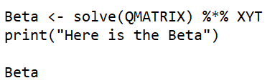
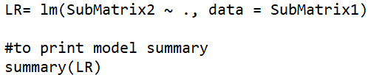

LR COMPUTATION
LR has been computed in the following three ways:
R+DBMS – Gamma matrix has been calculated using sql queries and further value of beta is computed using matrix operations
R – calculated using in-built function , lm()
Spark- difference between predicted and observed values and mean square error calculated to find the perfect model

Slide 4
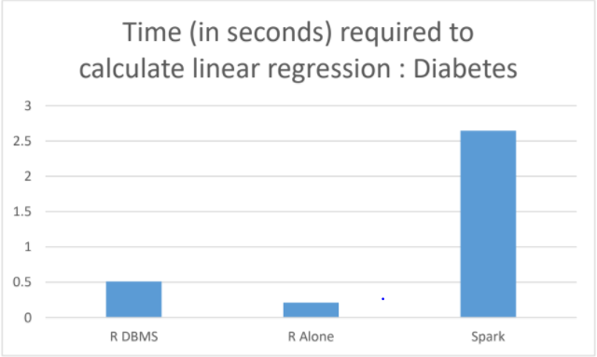
Comparison

Slide 5
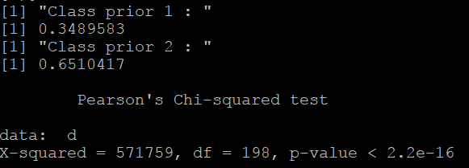
NAÏVE bayes
Computing a model- to get the mean per class and to compute the variance per class.
Scoring a test dataset
It involves:
Classify sub-tables based on class value(0,1)
Apply gamma function on each table
Form gamma matrix
Calculate the value of q and l
Calculate mean and standard deviation
Calculate class priors
Calculate chi-square , feature selection method

Slide 6
Programming languages used
R language
statistical language, which is fastest for small datasets but becomes slowest for large datasets.
Memory consumption problem in r- becomes very slow when we have lots of variables stored often requiring a lot of ram
SCALA
Simple and straightforward syntax and two third less code as compared to java.
Having many in-built functions as well

Slide 7
Systems used
Vertica
Works only on ubuntu 14.xx version and not on 16.xx version
Fast and powerful analytics tool
Spark
faster in memory and faster when running on disk
Supports java, Scala, python, r

